Slide 1
Perceived Entity-Linking for Robotic Agents

Slide 2
About Me

Slide 3
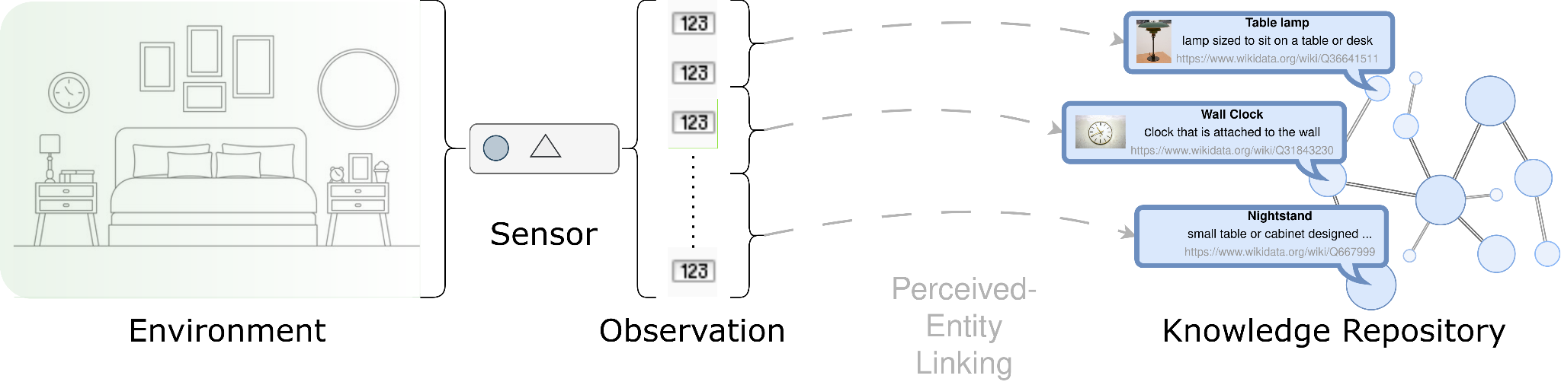
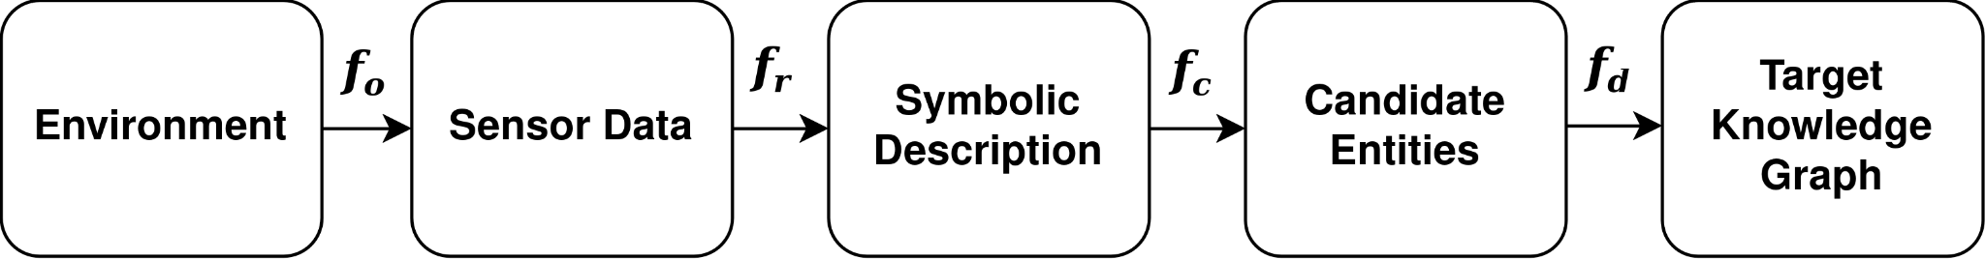
How to link sensory data to knowledge repositories?

Slide 4
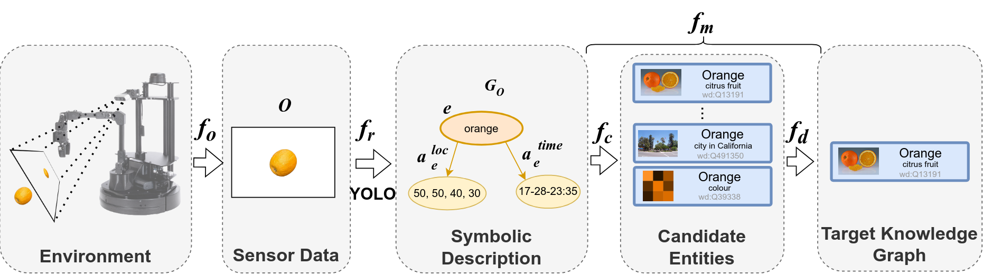
PEL Pipeline with EL

Slide 5
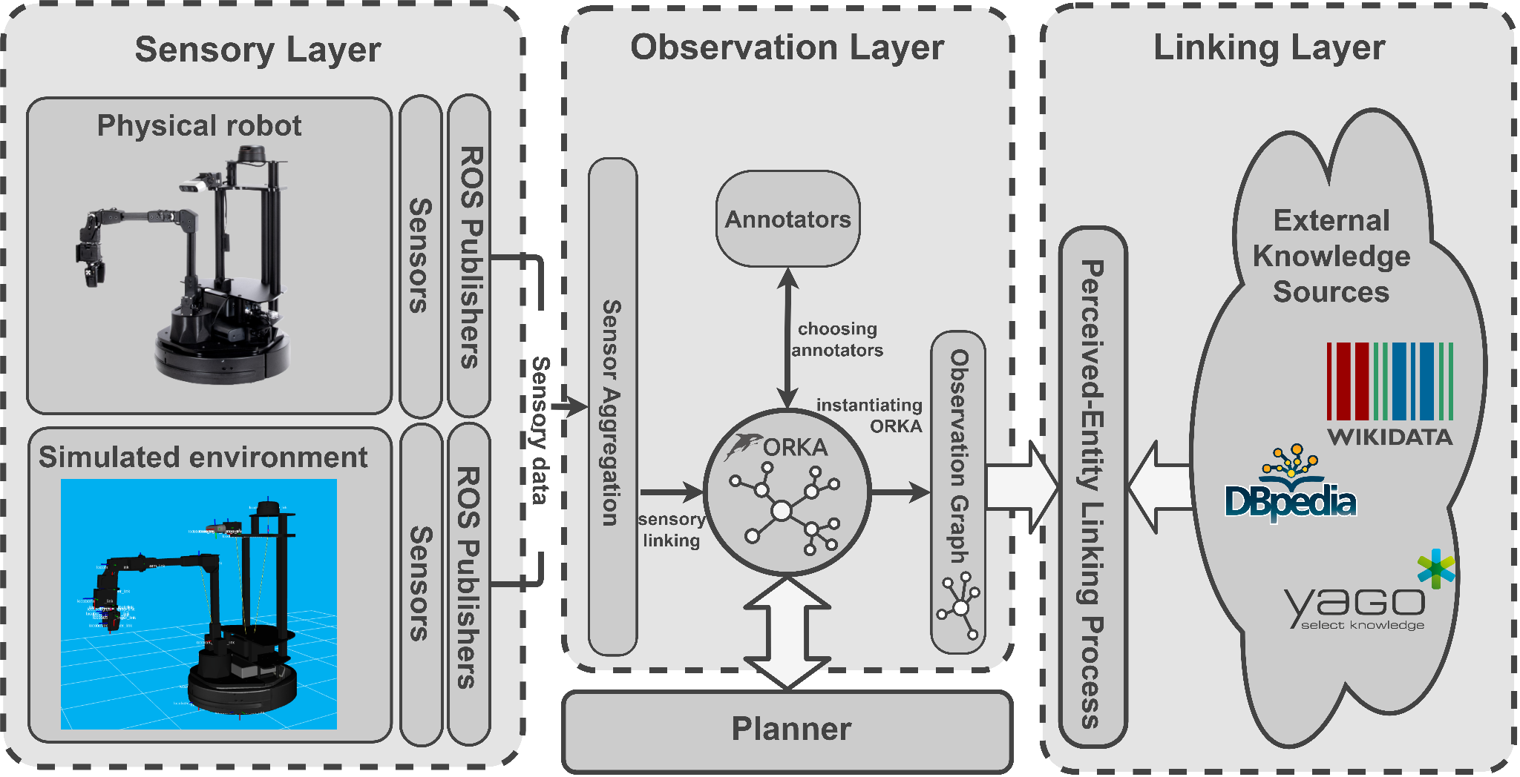
Perceived-Entity Linking System
Adamik et al.: Large-Scale Knowledge Graph as a Tool for Enhanced Robotic Perception, AAAI Fall Symposium, Unified Representations for Robotic Application Development (AAAI FSS - UR-RAD), 2024
Notes:
and once we had ORKA, we could move on to create a modular system where the PEL could be used.
We basically want to abstract away from the sensory layer, and with the use of ORKA, select different annotators to construct the observation graph, and then use the graph to perform the linking process
We presented this work last week at AAAI FSS

Slide 6
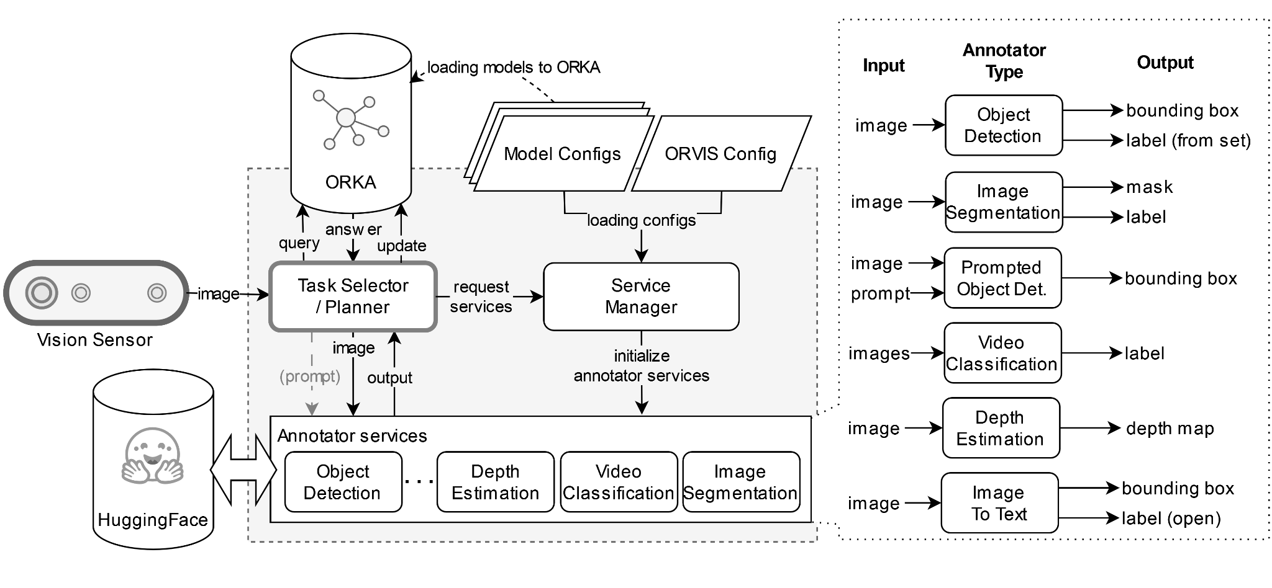
Ontology-Based Robot Vision System (ORVIS) - WIP
Notes:
The focus of this system is to leverage the model base that is hosted on huggingface, and to provide a framework that allows roboticists to reuse the models developed.

